Slide 1
JSON & Spring
Run Spring Server !!!
Dr Simon Lock
simon.lock@bristol.ac.uk

Slide 2
Aim of this session
Introduce the concept of JSON
Explore uses of JSON in development
Look at some basic parsing & interrogation
Consider more sophisticated parsing tools
What you will see today are MINIMAL examples
Just enough to get something up and running
You’ll probably want to extend & improve them !

Slide 3
What is JSON ?
Soz if you know this all already…
Didn’t want to take anything for granted
JSON - JavaScript Object Notation
Originally designed for transfer of JS “objects”
But adopted by many other prog. languages
Allow us to “Flat-pack” objects into textual format
For storage on a filesystem…
Or transfer across a network

Slide 4
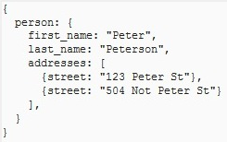
Example JSON document
JSON looks a bit like a programming language
(it is the data struct definition part of JS after all)
However there is NO behavioural aspect
It just consists of name:value pairs
Where values can be:
Atomic (e.g. an int)
Complex (an object)
An array (of things)

Slide 5
Why should we care ?
JSON is used everywhere - in particular when transferring data between web services !
Some JSON web services your might know of:
The Facebook “Graph”
National Rail enquiries (the “Huxley” proxy)
Met Office weather
Magic Seaweed live surf feed
Open Project !
etc.

Slide 6
Freedom !
One of the nice things about JSON is the freedom
Developers are free to define their own structure
You can put what you want, where you want it :o)
As a result many JSON documents are very ugly !
As we shall see later on !!!

Slide 7
Parsing JSON
Parsing involves reading in the JSON text
And reconstructing it as a set of “live” objects
We don’t need to do this ourselves !
Various parsers are already available
We will take a look at a couple of them
Parsing is not the end of the story though
We then have to interrogate the created objects to extract data that we need for our application

Slide 8
Spring Application
To illustrate JSON in Spring, we need an app !
Let’s make an app to interrogate OP !
Web Browser
Spring Server
OP Server

Slide 9
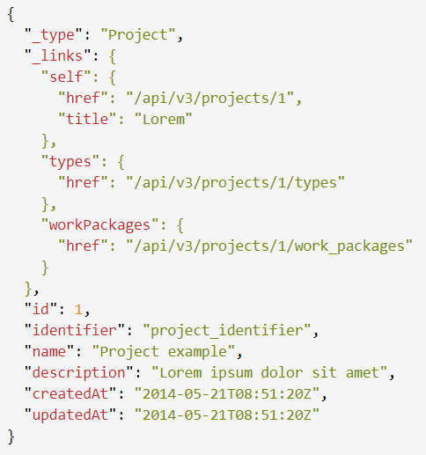
Example JSON for a project in OP

Slide 10
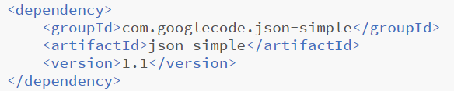
JSON-Simple
Simple, lightweight and fast parser
Provides basic features for reading/writing JSON
Add a dependency to your maven pom.xml file:

Slide 11
About JSON-Simple
Based around JSONObject and JSONArray
To provide individual and collection structures
(Basically extensions of HashMap and ArrayList)
Documentation can (currently) be found here:
http://alex-public-doc.s3.amazonaws.com/
json_simple-1.1/index.html
To pull out entities, we use the “get” methods…

Slide 12
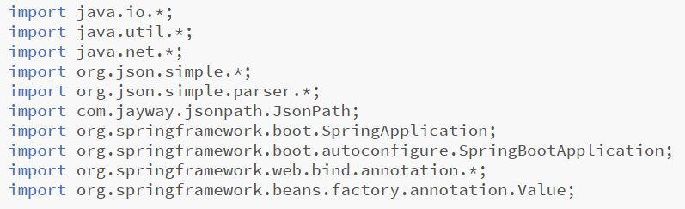
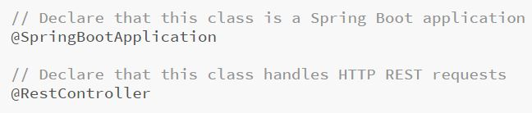
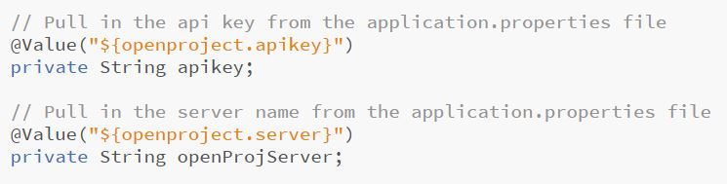

Slide 13
Application.properties
openproject.apikey: 5c1a6a8d4d22056269a67cb7
openproject.server: https://op.spe-hub.net/api/v3

Slide 14
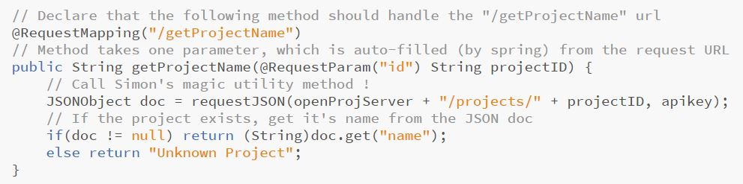
Requesting a project name (by ID)
http://127.0.0.1:8080/getProjectName?id=1

Slide 15
A more complex example?
Tally up the different types of work package in a project
For example: 3 phases, 5 tasks, 4 milestones

Slide 16
Design
When method is called, a project ID is passed in
We must query Open Project about that project
Then loop through all the work packages returned
They might be a “phase”, “task” or “milestone”
We need a running count (tally) of each WP type
Once tallied up, the number of each type should be returned to the browser for display

Slide 17
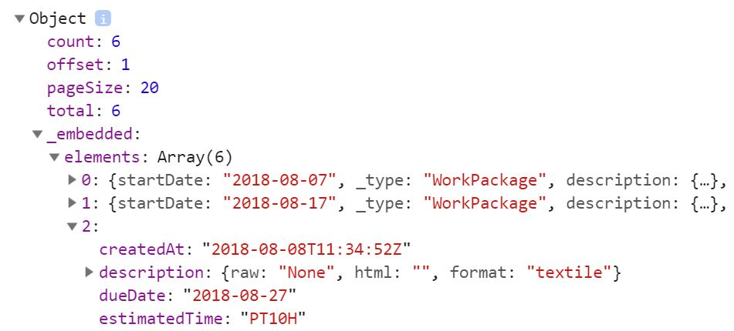
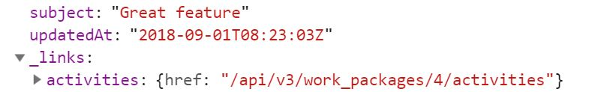

https://opserver/projects/{id}/work_packages
document
embedded
elements
2nd work package
links
type

Slide 18
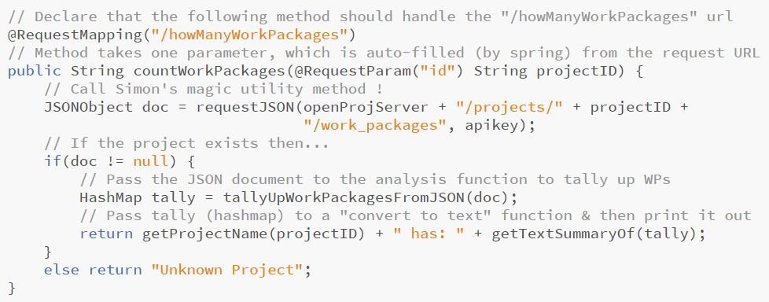
Count of work package types (by ID)
http://127.0.0.1:8080/howManyWorkPackages?id=1

Slide 19
Do we all know about HashMaps ?
Provides a fast access key:value pair store
A bit like a dictionary in Python
Uses a fancy indexing mechanism for efficiency
How it is implemented isn’t important right now
All we need to know is that it looks like this:
Key <String> | Value <Integer>
“phase” | 3
“task” | 5
“milestone” | 4

Slide 20
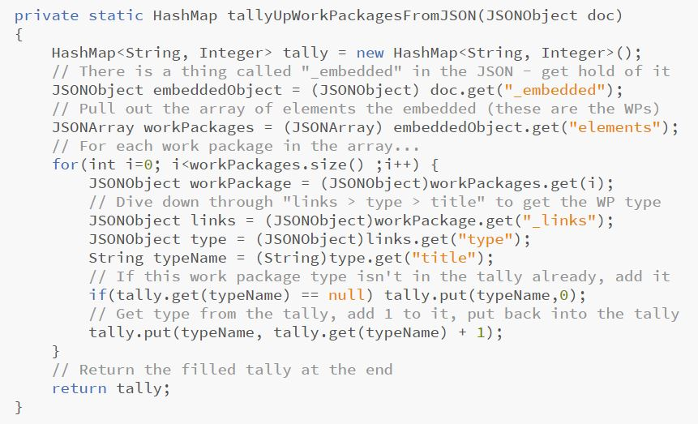
Interrogate the JSON

Slide 21
Simon’s magic utility method

Slide 22
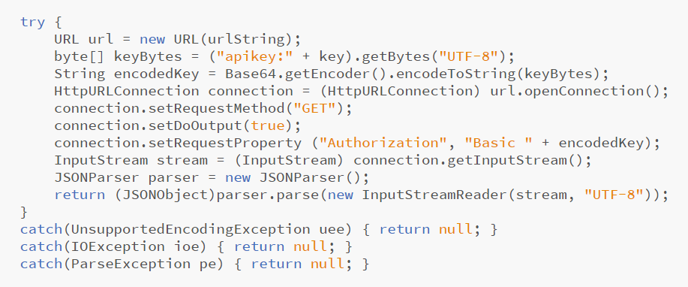
Making HTTP Requests in Spring

Slide 23
“Basic” Authorization (with API Key)

Slide 24
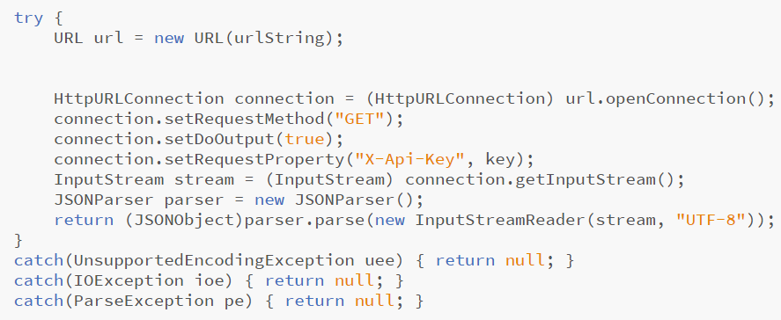
X-Api-Key Header Authentication

